Slide 1
WELCOME TO
HANDS-ON MATHS

Slide 2
Let’s Try On Some Hands-On Activity

Slide 3


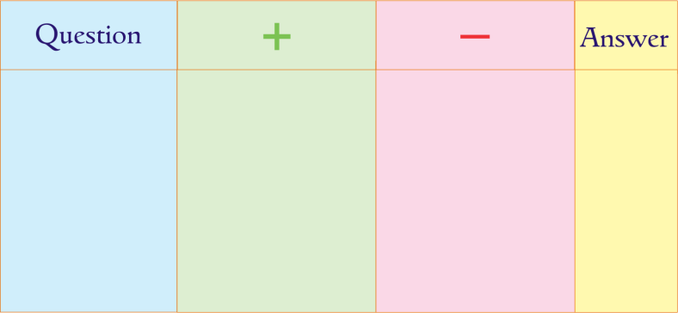
Please check if everybody has:
  10 red
  10 green
Buttons
  1
Worksheet

Slide 4
We have
POSITIVE numbers
NEGATIVE numbers
And ZERO
On the Number Line

Slide 5
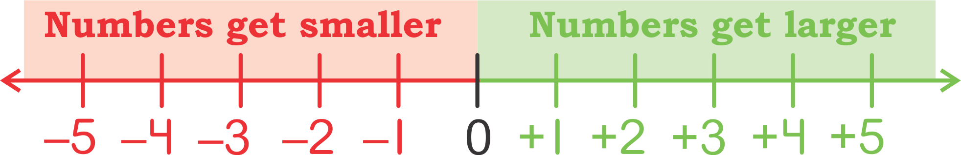
Number line showing Positive and Negative NumberS

Slide 6
For Positive Numbers Use Green Buttons
For Negative Numbers Use Red Buttons

Slide 7
Lets Solve Some
Sums On Positive & Negative Numbers

Slide 8
Solve
(+4) + (+3)

Slide 9
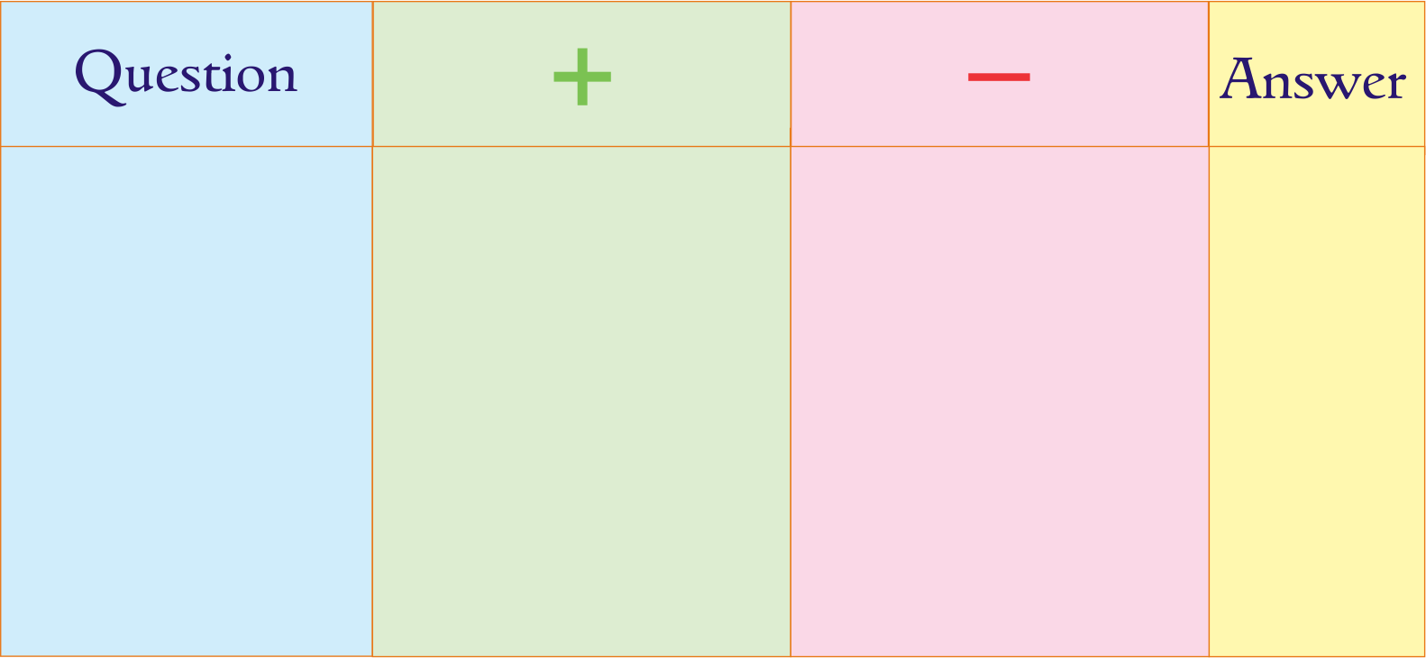

Take 4 green buttons for + 4 in the + column and 3 green buttons for +3 in the + column
(+4) + (+3)

Slide 10
Add up all the buttons
What is the answer?
(+4) + (+3)
+7

Slide 11
Solve
(+4) + (-3)

Slide 12

Take 4 green buttons for + 4 in the + column and 3 red buttons for –3 in the – column
(+4) + (–3)

Slide 13
Pair up 1 green and 1 red button and remove from the sheet
+1 – 1 = 0
(+4) + (–3)
(+4) + (–3)

Slide 14
What is left on the sheet?
One green button .
∴ (+4) + (– 3) = +1
= + 4 – 3 [+ – = – ]
= + 1

Slide 15
Pair up 1 green and 1 red button and remove from the sheet
+1 – 1 = 0
(+4) + (–3)
(+4) + (–3)
+ 1

Slide 16
Solve
(+4) - (+3)

Slide 17
Take 4 green buttons for + 4 in the + column and 3 green buttons for +3 in the + column
(+4) – (+3)

Slide 18
– ( + 3)
= – 3 [– + = –]
∴ Change 3 green buttons for 3 red buttons

Slide 19
(+4) – (+3)

Slide 20
(+4) – (+3)

Slide 21
Pair up 1 green and 1 red button and remove from the sheet
+1 – 1 = 0
(+4) + (–3)
(+4) – (+3)

Slide 22
What is left on the sheet?
One green button.
∴ (+4) – (+3) = +1
= + 4 – 3 [+ – = – ]
= + 1

Slide 23
Pair up 1 green and 1 red button and remove from the sheet
+1 – 1 = 0
(+4) + (–3)
(+4) – (+3)
+1

Slide 24
Solve
(+4) - (-3)

Slide 25
Take 4 green buttons for + 4 in the + column and 3 red buttons for –3 in the – column
(+4) – (–3)

Slide 26
– ( – 3)
= + 3 [ – – = + ]
∴ Change 3 red buttons for 3 green buttons

Slide 27
(+4) – (–3)

Slide 28
(+4) – (–3)

Slide 29
Add up all the buttons
What is the answer?
(+4) – (–3)
+7

Slide 30
What are the Positive and Negative Numbers alongwith Zero Called ?

Slide 31
INTEGERS

Slide 32
  Thank you
  Very Much !

